Slide 1
Clipping and Comparator Circuits
Muhaimin Bin Munir

Slide 2
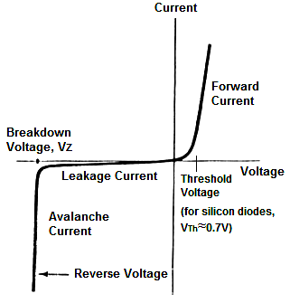
Diode
Threshold Voltage - This is the voltage which must be supplied to the diode for it to conduct any considerable forward current.
Forward Current - The current flowing through the diode in the direction of lower resistance
Breakdown Voltage - This is the reverse voltage that when applied to the diode will cause the diode junctions to break down and conduct a large amount of current, even though the voltage is applied with incorrect polarity.
Reverse (leakage) Current - A conventional diode will conduct some current even when reverse voltage is applied.

Slide 3
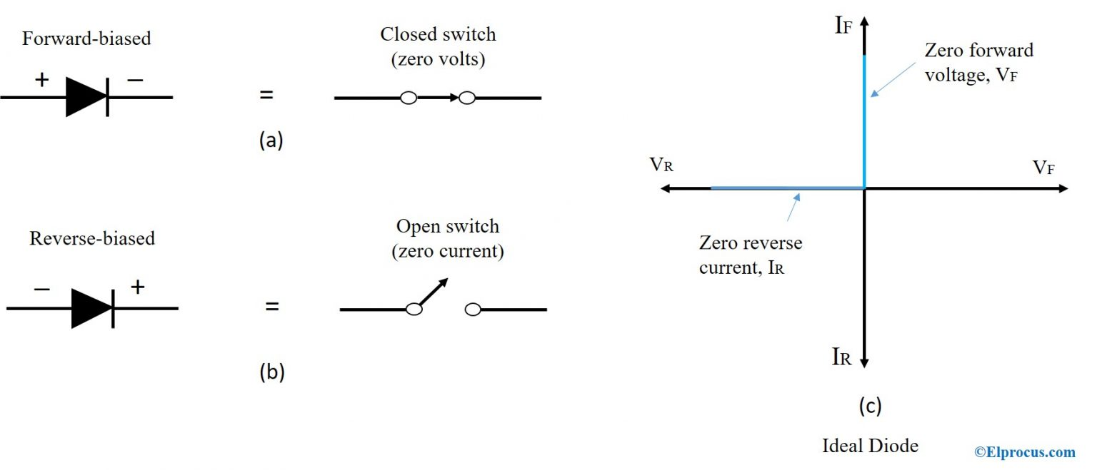
Diode Approximation
First Approximation
Diode approximation is a mathematical method used to approximate the nonlinear behavior of real diodes to enable calculations and circuit analysis.
In the first approximation method, the diode is considered as a forward-biased diode and as a closed switch with zero voltage drop.

Slide 4
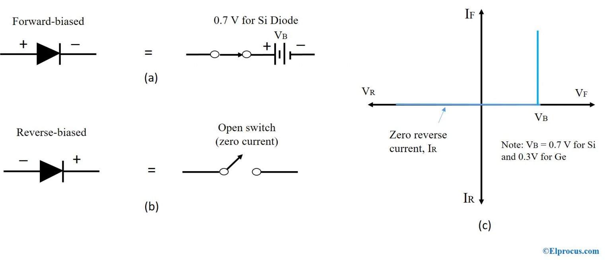
Diode Approximation
Second Approximation
In the second approximation, the diode is considered as a forward-biased diode in series with a battery to turn on the device.

Slide 5
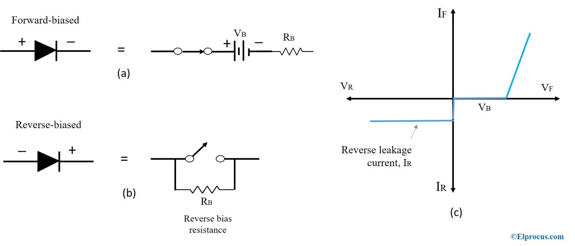
Diode Approximation
Third Approximation
The third approximation of a diode includes voltage across the diode and voltage across bulk resistance, R_{B}. The bulk resistance, R_{B} corresponds to the resistance of p and n materials. This resistance changes based on the amount of forwarding voltage and the current flowing through the diode at any given time.

Slide 6
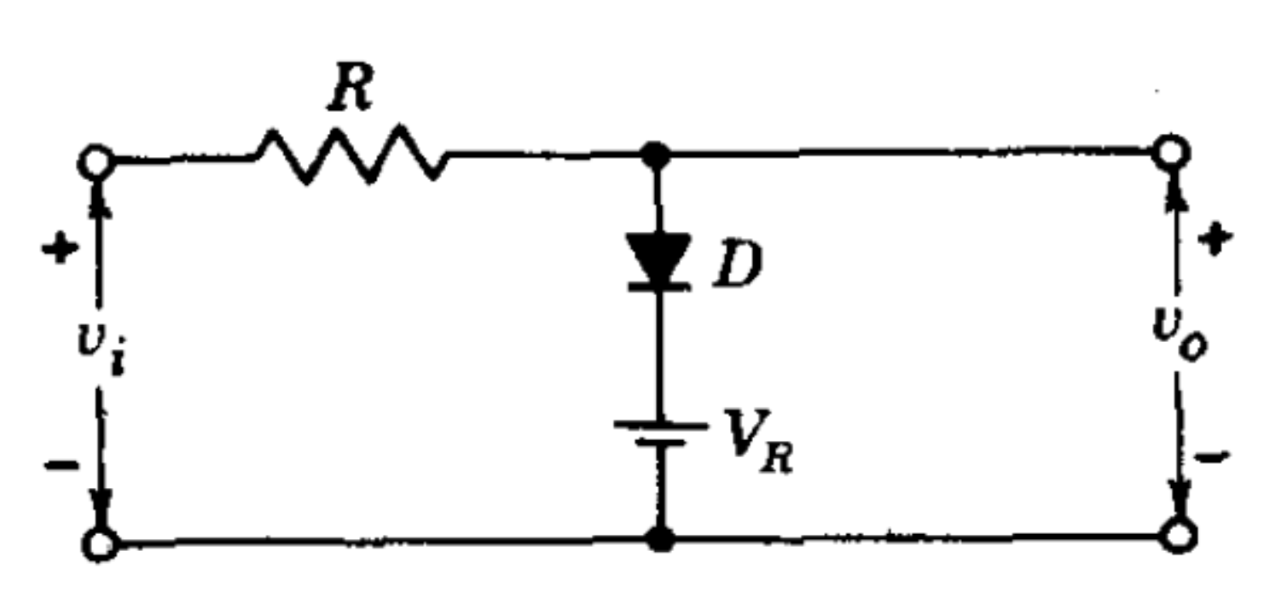
Diode Clippers

Slide 7
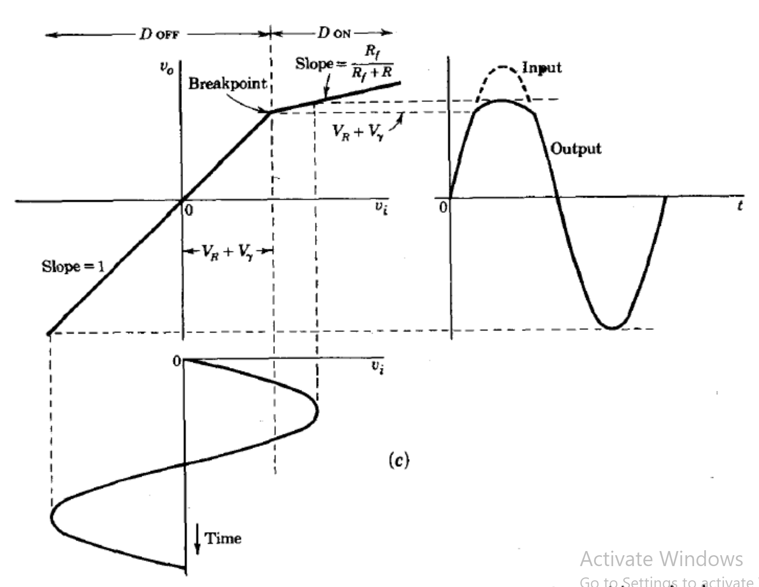

Slide 8
V_{i} = I (R + R_{f})
V_{o} = IR_{f}
V_{o}/ V_{i} = R_{f} / (R + R_{f}) V_{o} = R_{f} / (R + R_{f}) x V_{i}

Slide 9
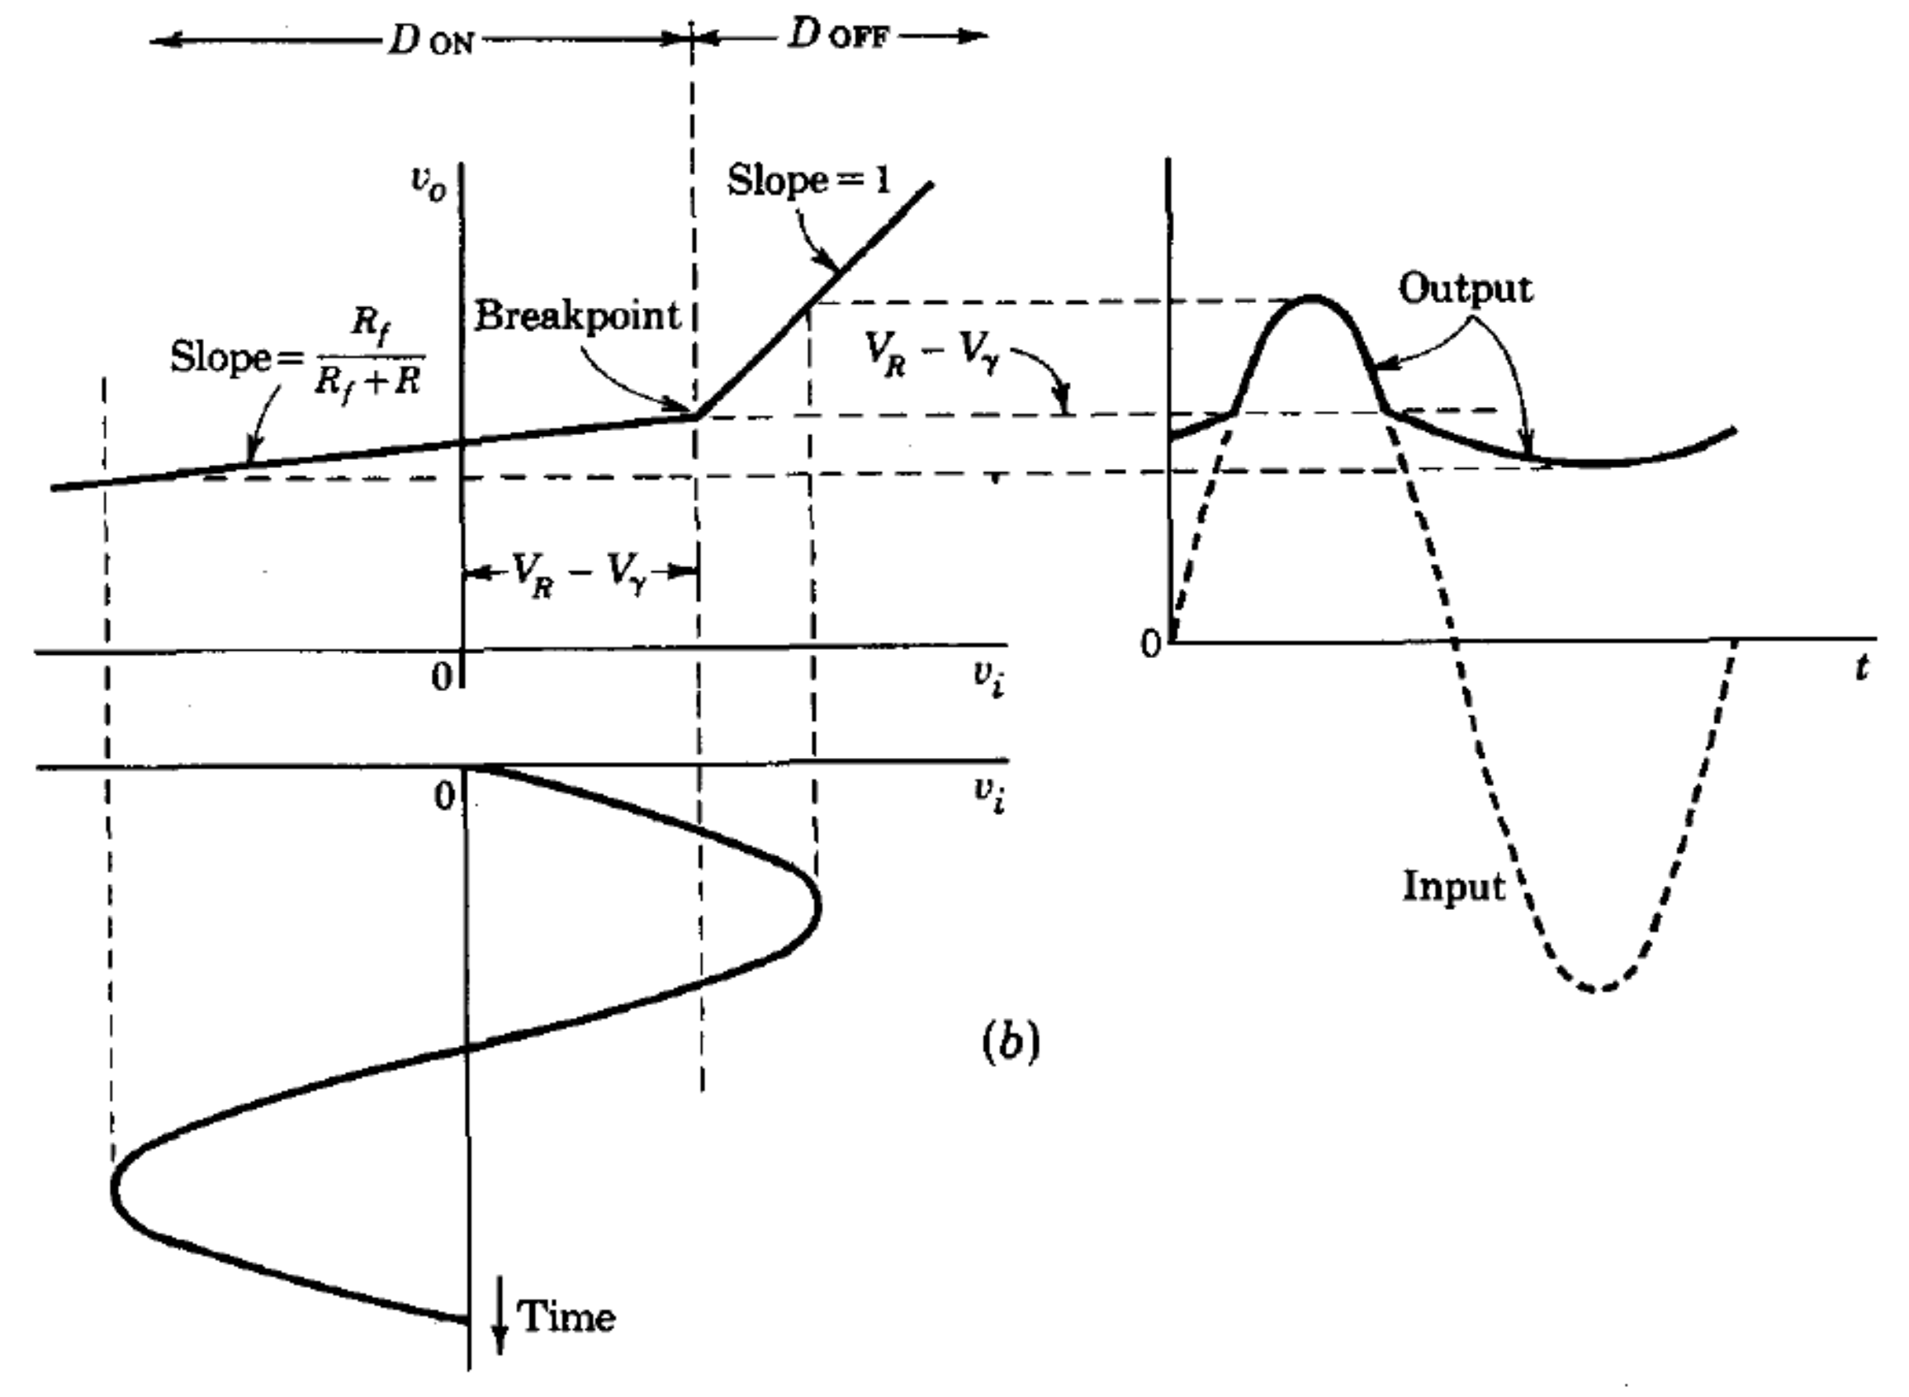
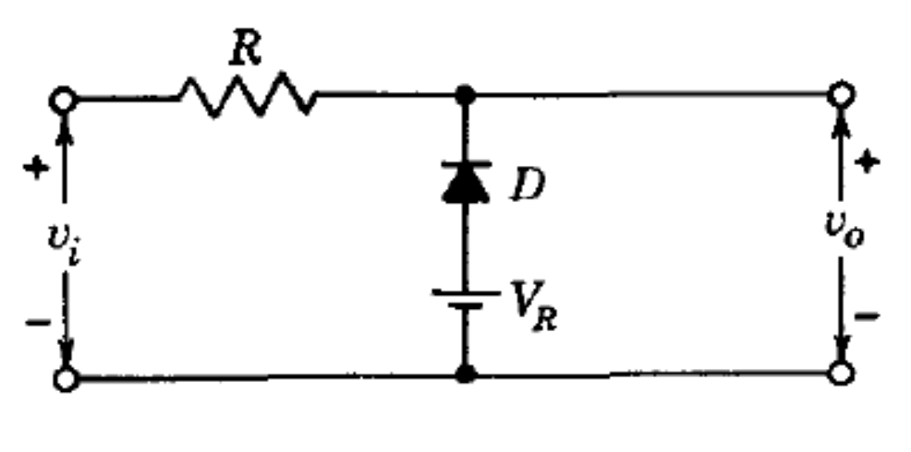

Slide 10
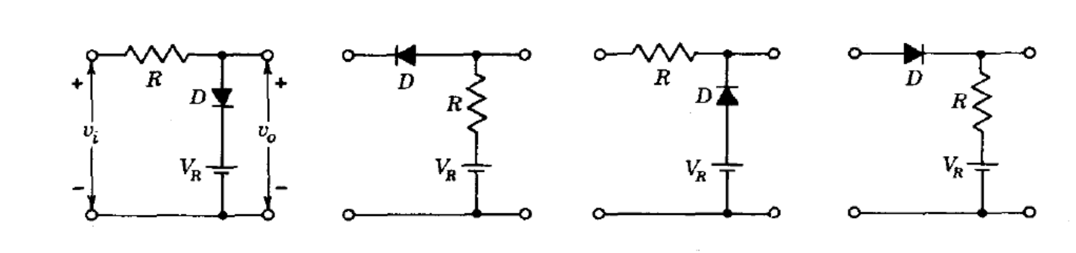
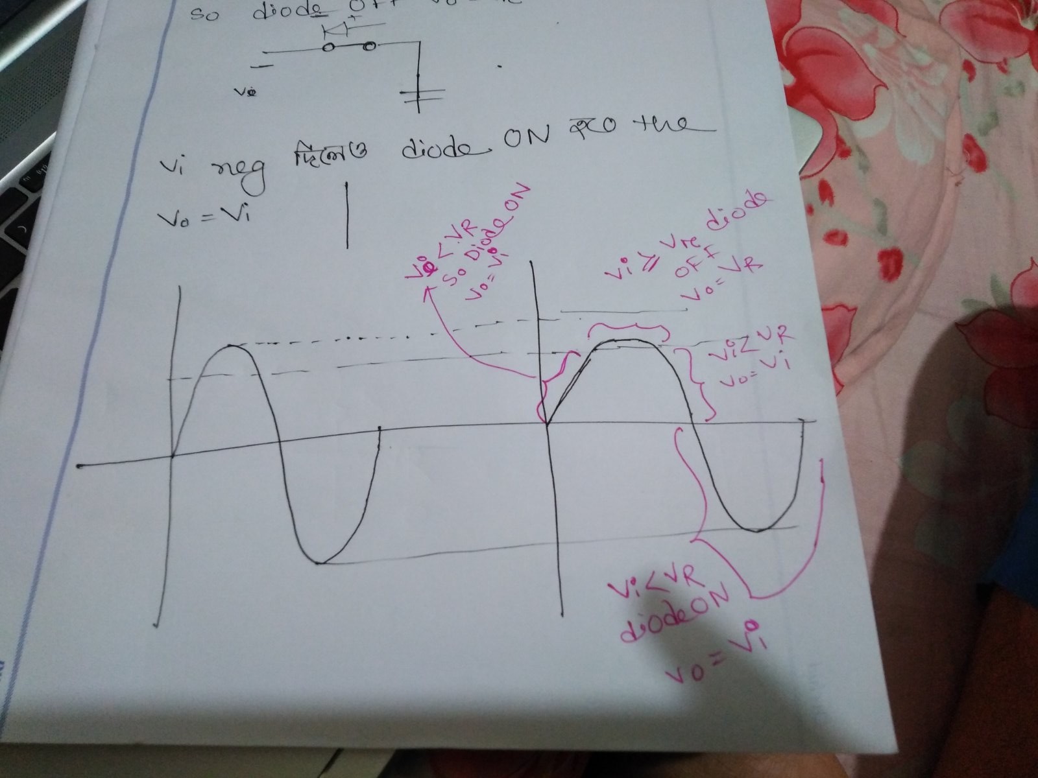
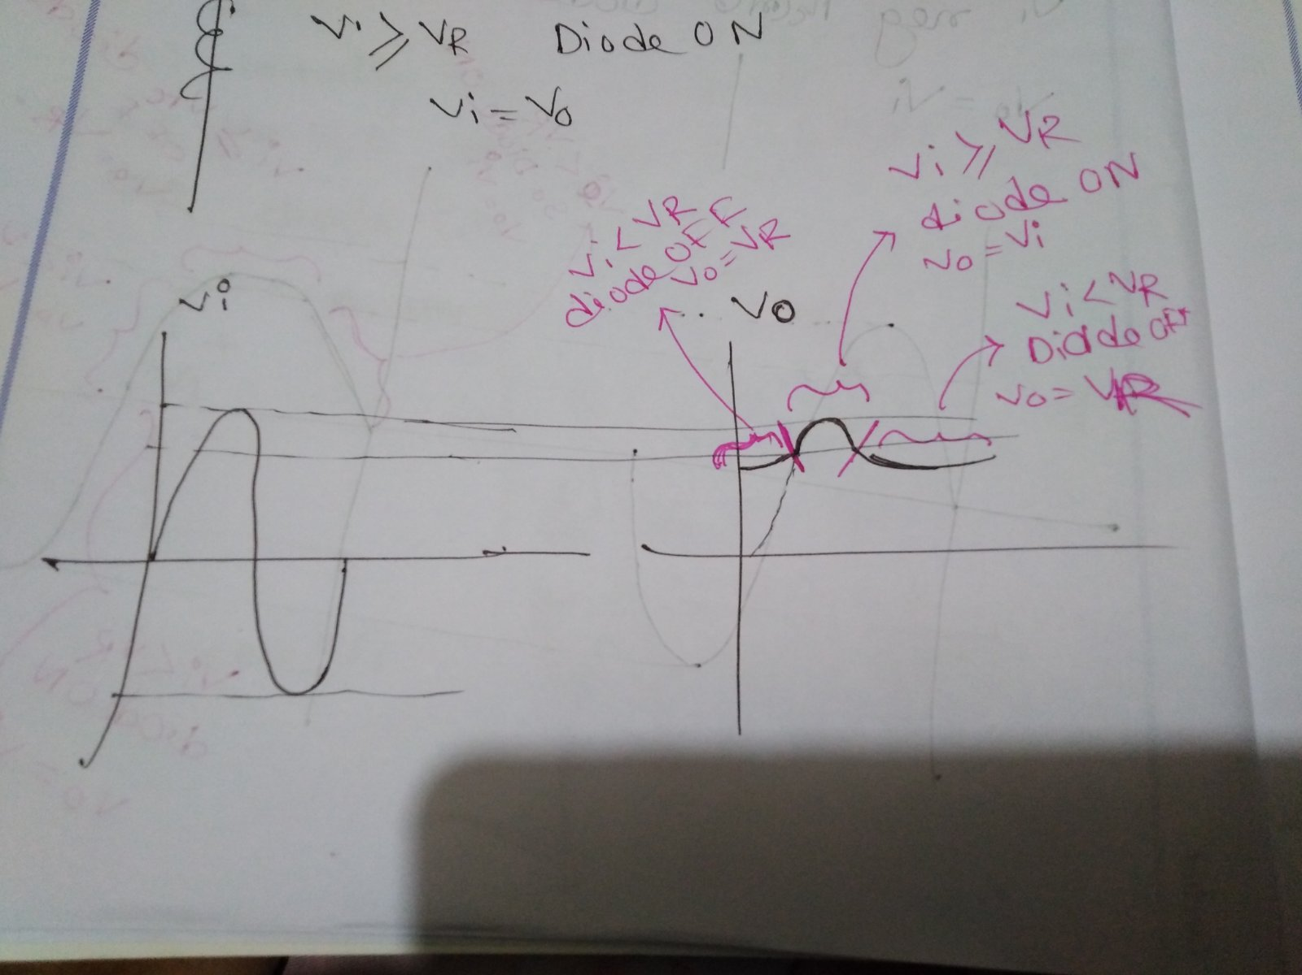
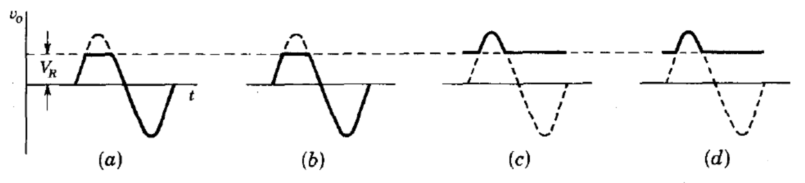
V_{i} < V_{r} -- Diode on -- V_{o} = V_{i} V_{i} ≥ V_{r} -- Diode off -- V_{o} = V_{r}
V_{i} ≥ V_{r} -- Diode on -- V_{o} = V_{i} V_{i} < V_{r} -- Diode off -- V_{o} = V_{r}

Slide 11
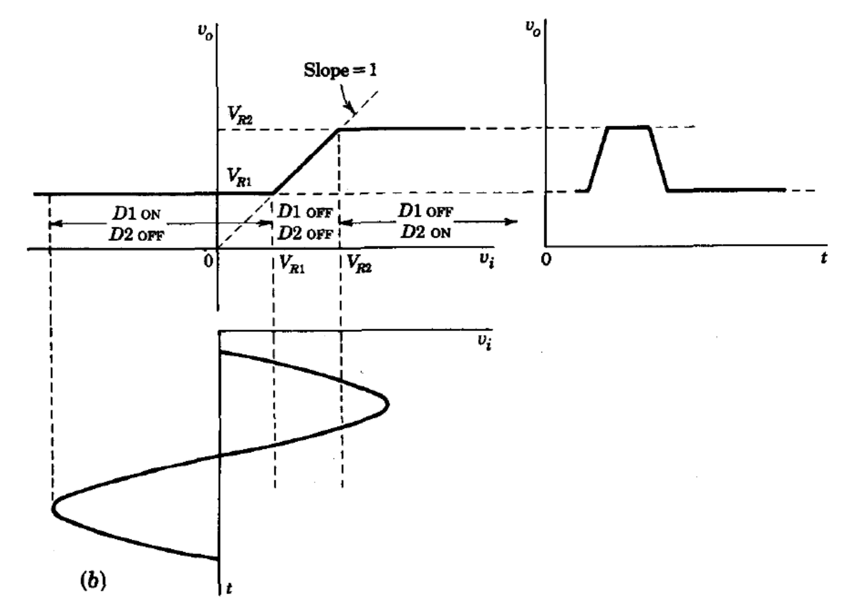
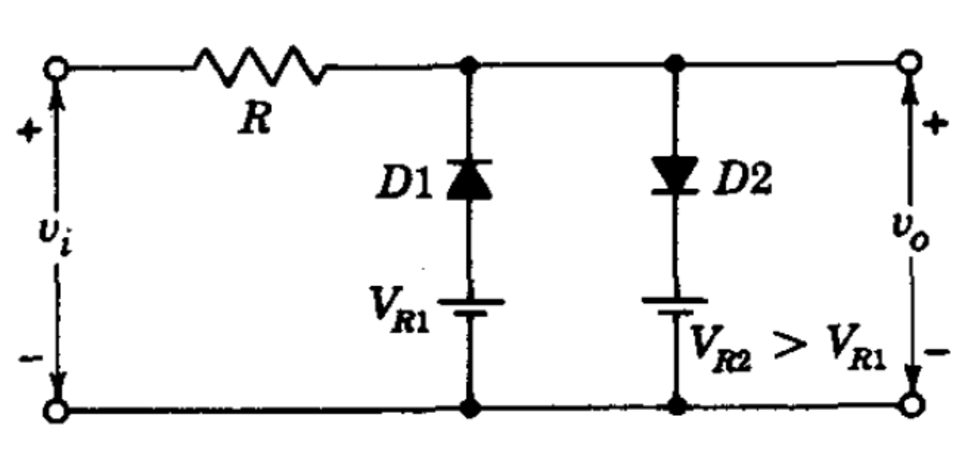
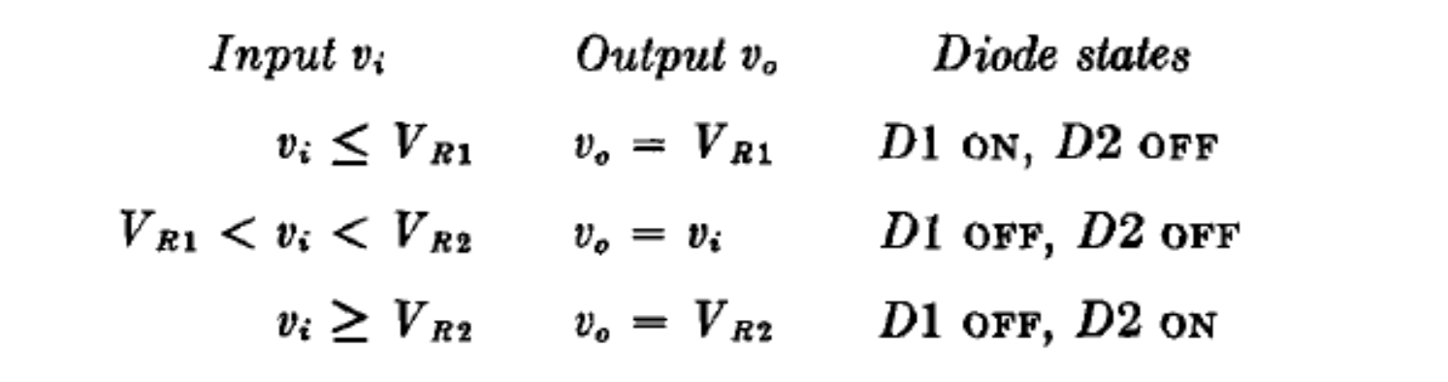

Slide 12
“If people supply you negative voltage, be a Zenner Diode”

